Slide 1
2018 Young Data Scientist Challenge
Submission
Name : Sarthak Singh
College : Maharaja Agrasen Institute of Technology

Slide 2
Section A : Approach

Slide 3
Problem Statement
Mekktronix is a global premium electronics manufacturing companies provides electronic devices across globe through their large distributor channel. Recently company is observing lot of fluctuations in their demand forecasting across geographies affecting their revenue. The company has reached out to build a machine learning driven forecasting solution to predict sales accurately.
Thus, we need to build a model that can accurately forecast the sales such that the company can cope up with the demands more easily.

Slide 4
Approach
PROMOTIONAL EXPENSES
As we know, that the promotional expenses can majorly affect the sales as more the promotion is more the sale can be, hence we took the promotional expenses as a feature in our model.

Slide 5
Approach
PROMOTIONAL EXPENSES
The promotional expenses were extracted from the dataset provided(promotional_expense.csv) and it was merged with training dataset.

Slide 6
Approach
HOLIDAYS
Holidays can cause a major affect on the sales of a day, since people prefer to buy new products on some special occasions, similary the number of holidays in a month can affect the sales of that month.
Hence we took number of holidays in a month as one of the features.

Slide 7
Approach
HOLIDAYS
The number of holidays in a month was calculated using the provided dataset(holidays.xlsx).
We counted the number of holidays in a month by using a loop and the added this feature to the training dataset.

Slide 8
Approach
Note
We had to add the promotional expenses and number of holidays in a month to our provided test set too(because they are features in our model). That was done by the merging them with the test dataset.

Slide 9
Approach
Model Selection
Finally, when our data was prepared, we splitted the training set into X_train and X_test such that we can evaluate performance of various algorithms and then choose the best.
We used three regression ensemble algorithms to train our model :
1) ExtraTreesRegressor
2) RandomForestRegressor
3) GradientBoostingRegressor

Slide 10
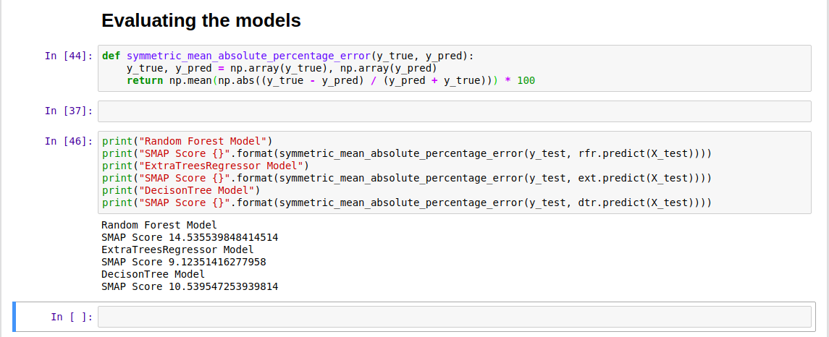
Approach

Slide 11
Approach
Model Selection
Finally, when the algorithms were done predicting, we got that ExtraTreeRegressor was the best among them and hence it was used to forecast the Sales in the original test dataset.

